Slide 1

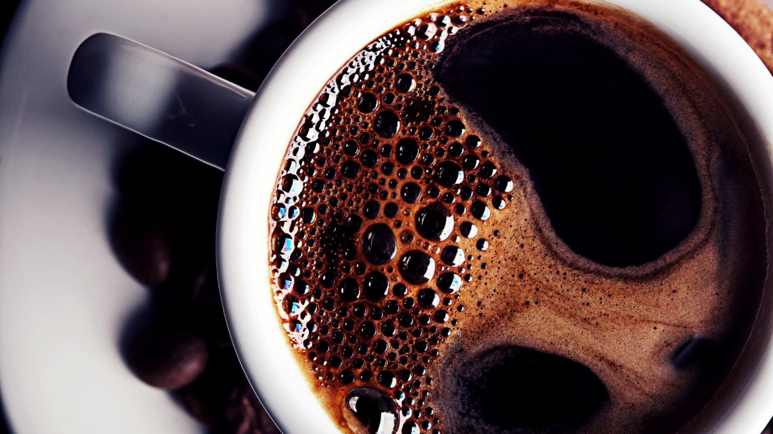
Fake News Prediction
Allaa El-khodr
Dwaipayan Chakraborty

Slide 2
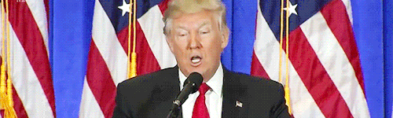
Motivation
Information is power
News impacts several domains:
Election
Stock Market
Sales
Social Conflicts
The internet, computation capabilities and digital data availability: makes it most feasible

Slide 3
Outline
Data
Preprocessing
Models
Results
Conclusion

Slide 4
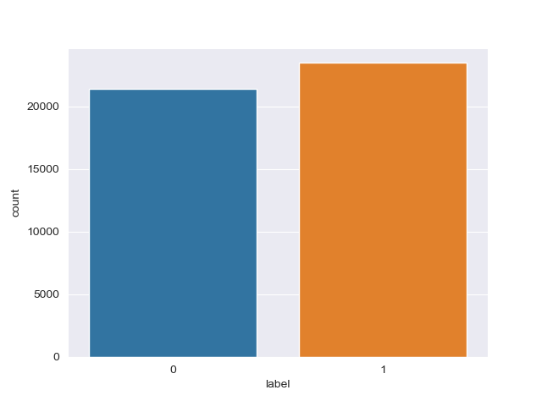
Dataset: Overview
Kaggle Dataset
Two datasets for fake and real news
Structure of the datasets:
4 columns: title, text, subject, date
21418 true news articles (label 0)
23489 fake news articles (label 1)

Slide 5
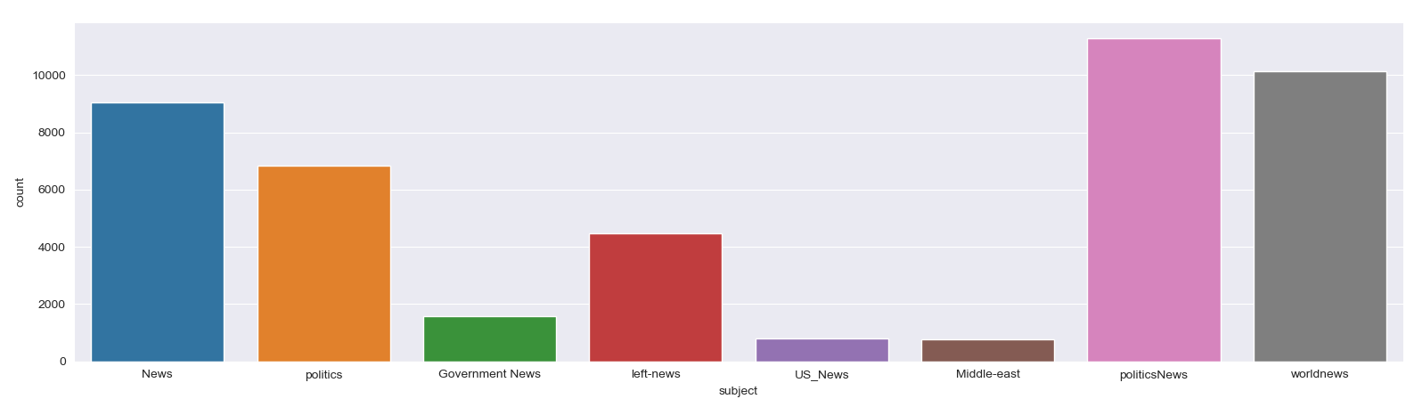
Dataset: Subjects

Slide 6
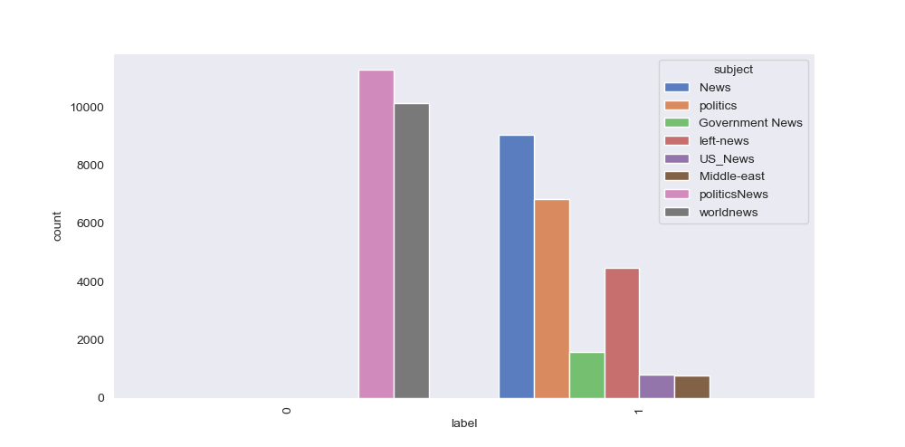
Dataset: Label of subjects

Slide 7
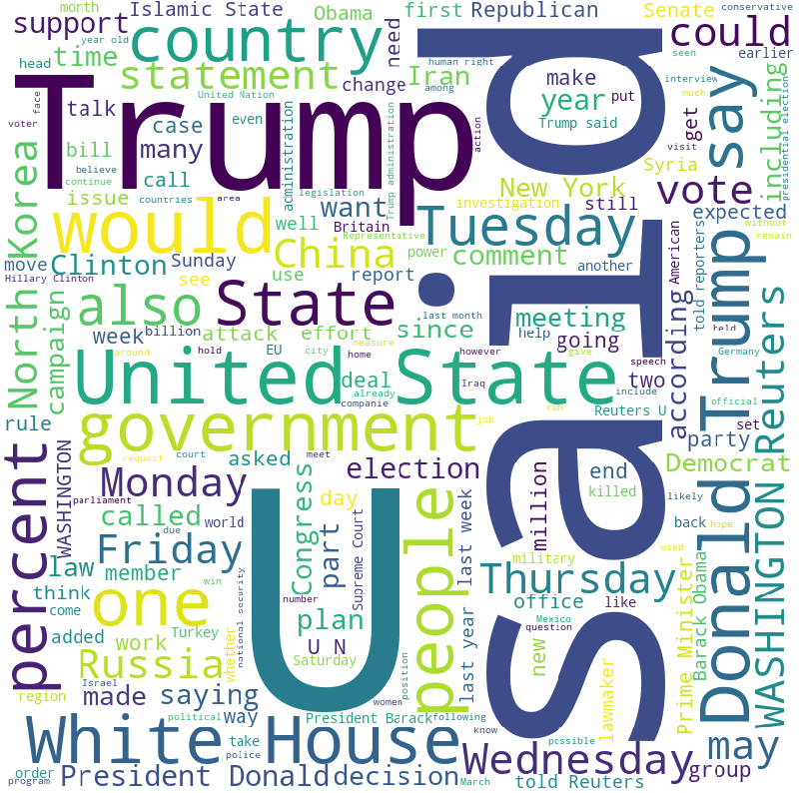
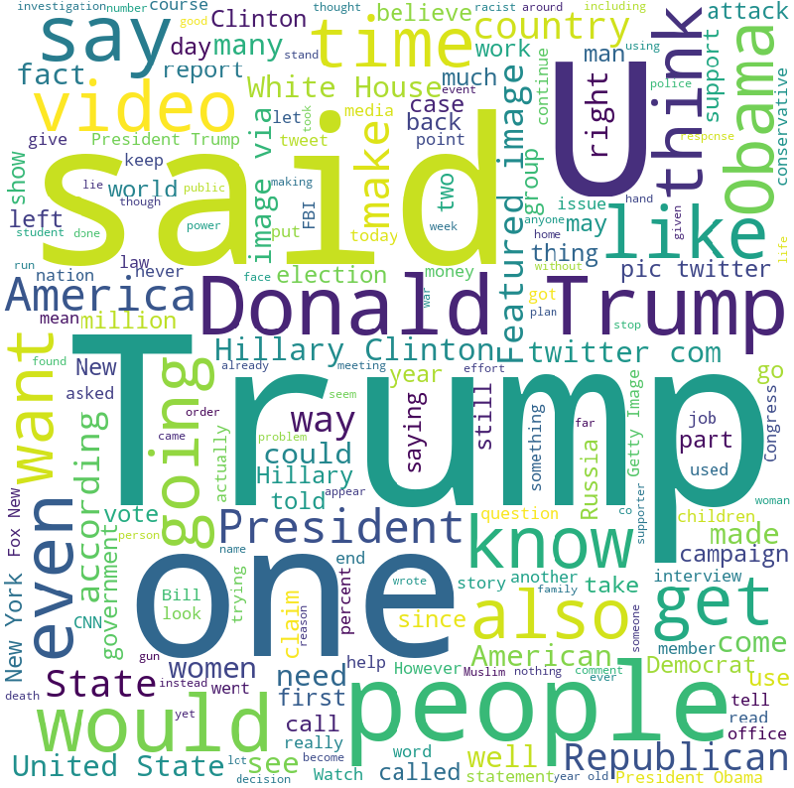
Dataset: Most frequent words
True News
Fake News

Slide 8
Outline
Data
Preprocessing
Models
Results
Conclusion

Slide 9
Preprocessing: Overview
Some of the text features don’t have an impact on the prediction
The NLTK Package (Natural Language Toolkit) was used to :
Import stop words for the English language
Remove the stop words and punctuation in the articles
Remove numbers in the articles
Tokenizing
Lemmatizing

Slide 10

Preprocessing: Removing stop words
Stop words are commonly used words
“the”, “an”, “a”, “in”
Goal: Ignore the stop words
Don’t influence the content of the articles

Slide 11

Preprocessing: Removing stop words
Example for removing the stop words:

Slide 12

Preprocessing: Tokenizing
Splits the articles into smaller units
Smaller units (tokens): Words
Example:

Slide 13

Preprocessing: Lemmatizing
Process to convert words into the root form
Reduction of the inflectional forms
“Normalization”
Example:

Slide 14
Preprocessing: TF IDF
Convert textual data to numeric form
Counter with a consideration of the frequency
Example:
Document 1: “I love dogs”
Document 2: “I hate dogs and knitting”

Slide 15
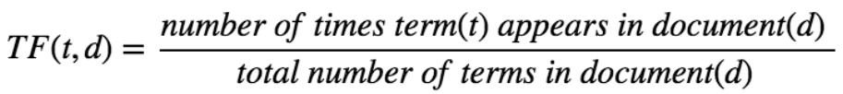
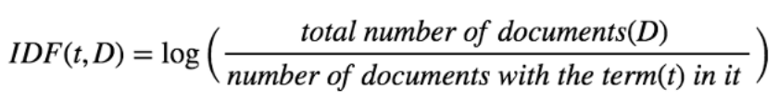
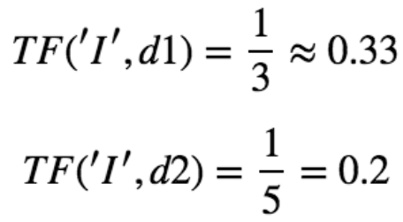
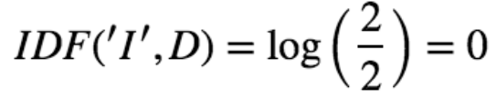
Preprocessing: TF IDF – Example
Term Frequency (TF):
Inverse Document Frequency (IDF):

Slide 16
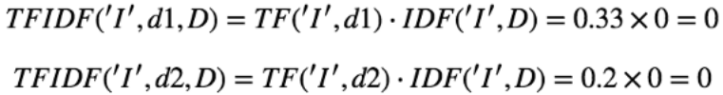
Preprocessing: TF IDF – Example
TF IDF:
TF IDF score for the term “I” is 0
Not informative to differentiate between documents

Slide 17
Outline
Data
Preprocessing
Models
Results
Conclusion

Slide 18
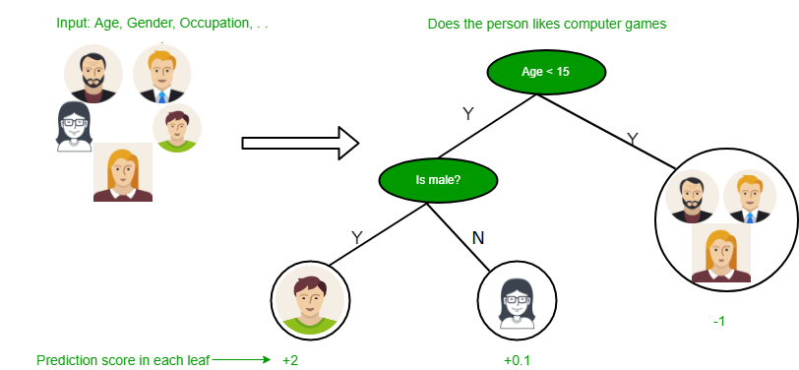
Model: Decision Tree
Learns from data to approximate a sine curve with if-then-else decision rules
Breaks the dataset into smaller subsets by measuring the entropy
Until all the data belongs to the same class

Slide 19
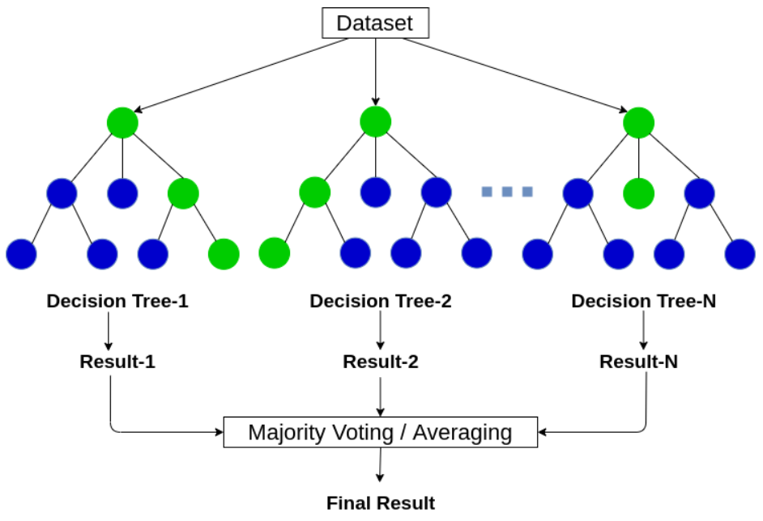
Model: Random Forest
An ensemble approach to finding the decision tree that best fits the training data
By creating many decision trees and then determining the "average" one.
Building each of the decision trees from a random selection of features

Slide 20
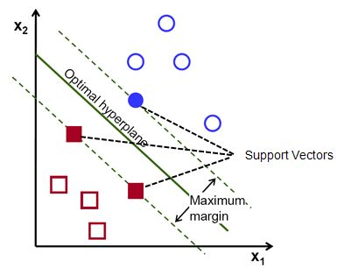
Model: Support Vector Machine
Finding a hyperplane that divides a dataset into two classes
Support Vectors are the nearest datapoints to the hyperplane
Works well for binary classification and nonlinear problems

Slide 21
Outline
Data
Preprocessing
Models
Results
Conclusion

Slide 22
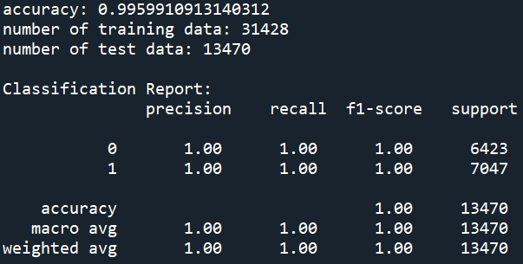
Results: Decision Tree

Slide 23
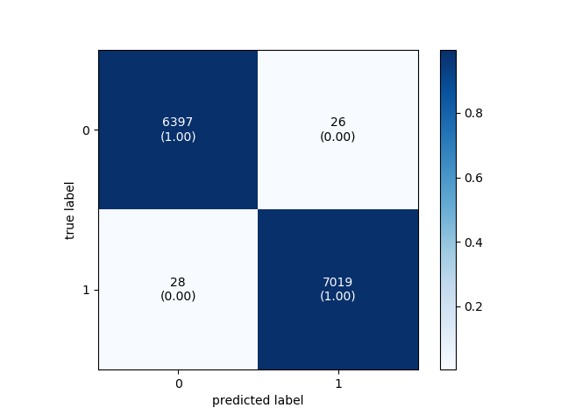
Results: Decision Tree

Slide 24
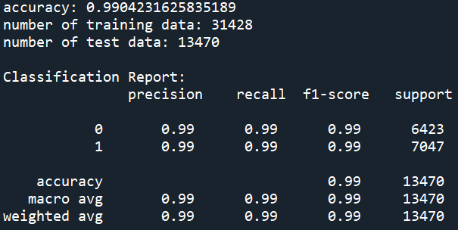
Results: Random Forest

Slide 25

Results: Random Forest

Slide 26
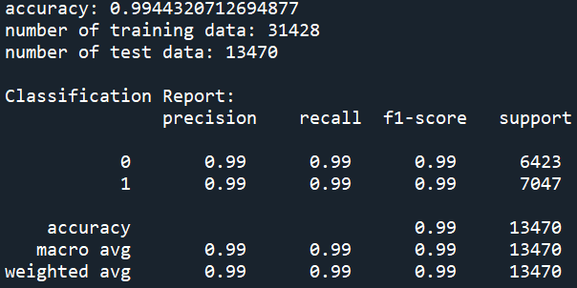
Results: Support Vector Machine

Slide 27

Results: Support Vector Machine

Slide 28
Outline
Data
Preprocessing
Models
Results
Conclusion

Slide 29
Conclusion
ML models were implemented for fake news prediction
ML models can train from available real big dataset
The models can predict true news from a fake news with reasonable accuracy
Decision Tree has better accuracy than Random Forest and SVM
SVM has less chances of overfitting and better accuracy than Random Forest

Slide 30
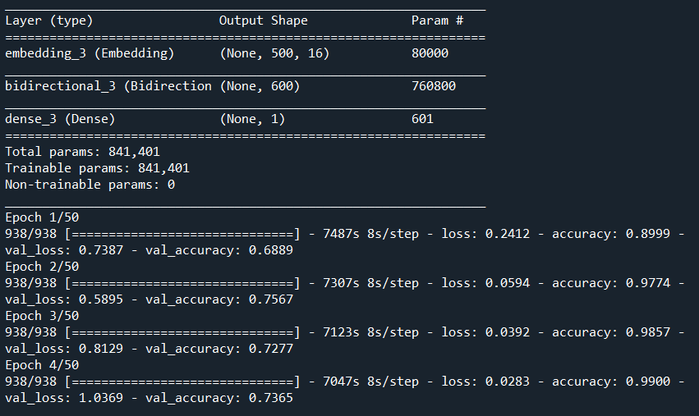
Future work
Using LSTM to compare results
Initial results show reasonable accuracy
Needs optimization

Slide 31
References
https://www.kaggle.com/clmentbisaillon/fake-and-real-news-dataset
https://towardsdatascience.com/another-twitter-sentiment-analysis-with-python-part-5-50b4e87d9bdd
https://www.kdnuggets.com/2016/07/support-vector-machines-simple-explanation.html
https://chiragsehra42.medium.com/decision-trees-explained-easily-28f23241248

